Slide 1

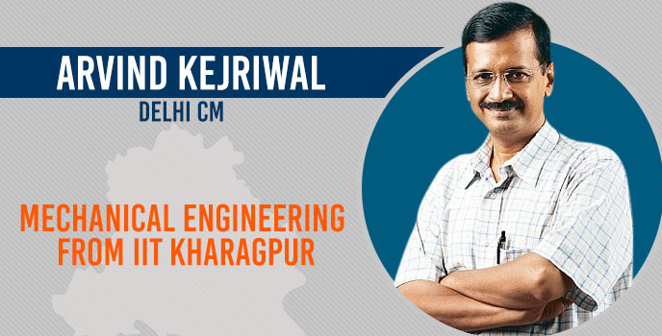
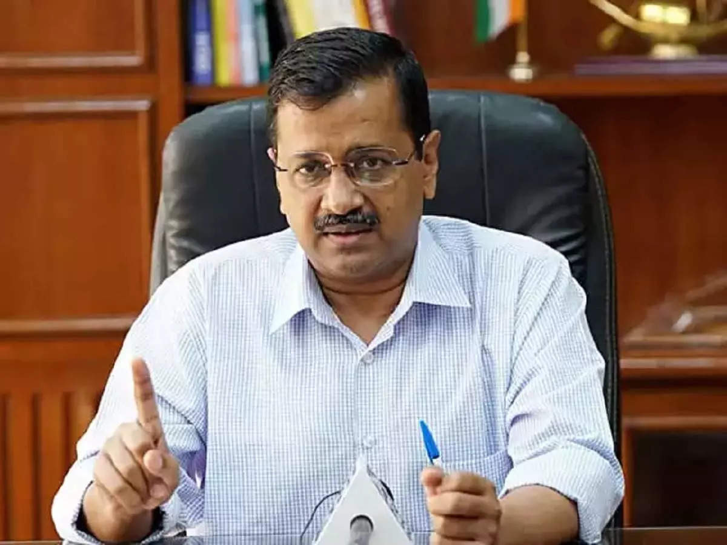
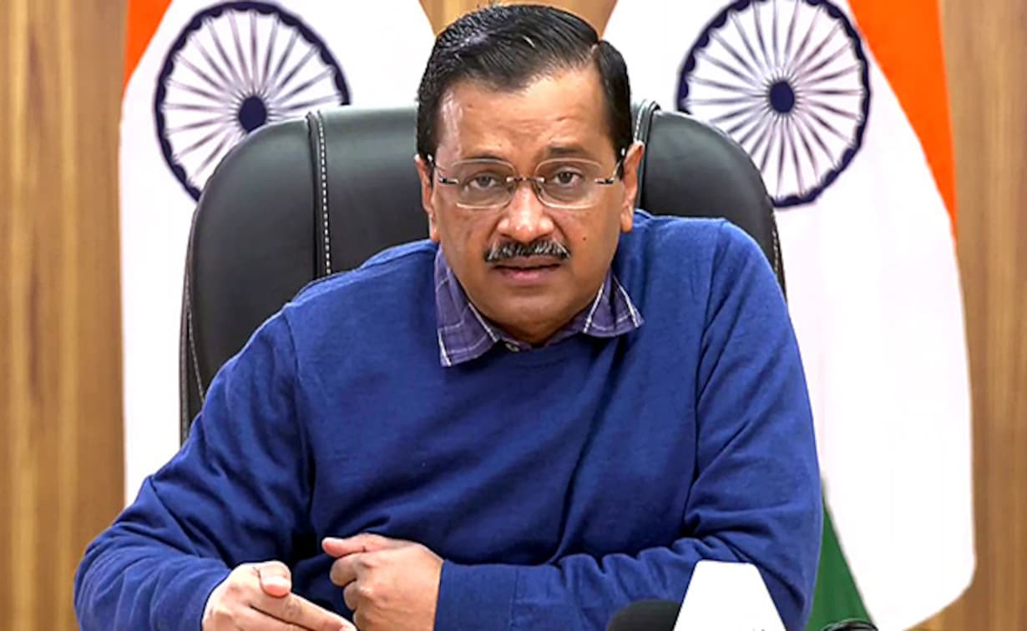

Arvind Kejriwal: A Visionary Leader
Leadership and Management [GELM-275]
Submitted To : Brig Gen Md Mahboob Sarwar
Presenters:
Aunindya Prosad Saha 202114014
Anika Tasnim 202214008
Maisha Nanjeeba 202214033
Md. Nahul Rahman 202214049
Mst. Nusrat Jahan 202214072
Sumaiya Yeasmin 202214102
Suraiya Mustari Labiba 202214103

Slide 2
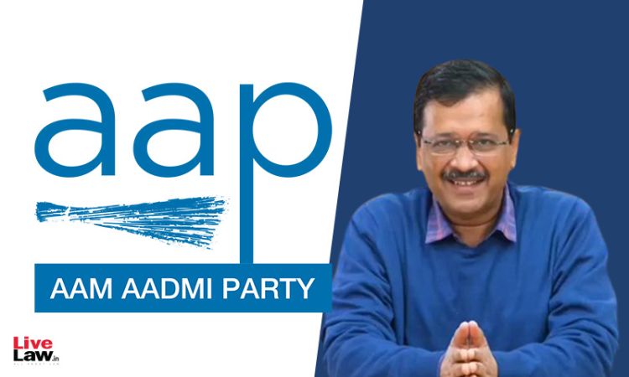
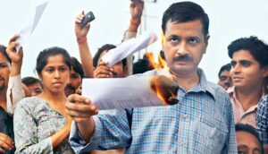
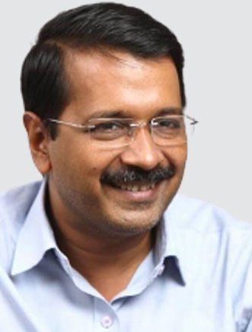
Introduction
Arvind Kejriwal, a mechanical engineer turned politician, is the current Chief Minister of Delhi. He has been a notable figure in Indian politics since his involvement in the India Against Corruption movement in 2011.
2

Slide 3
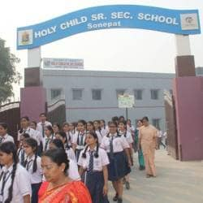
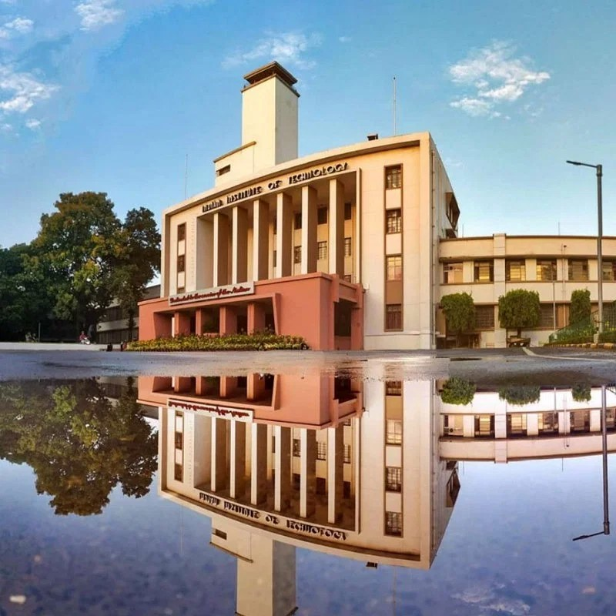
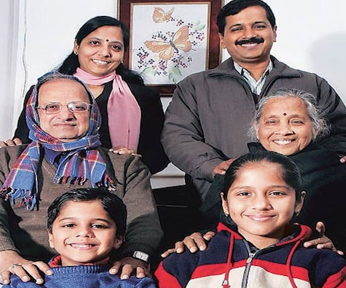
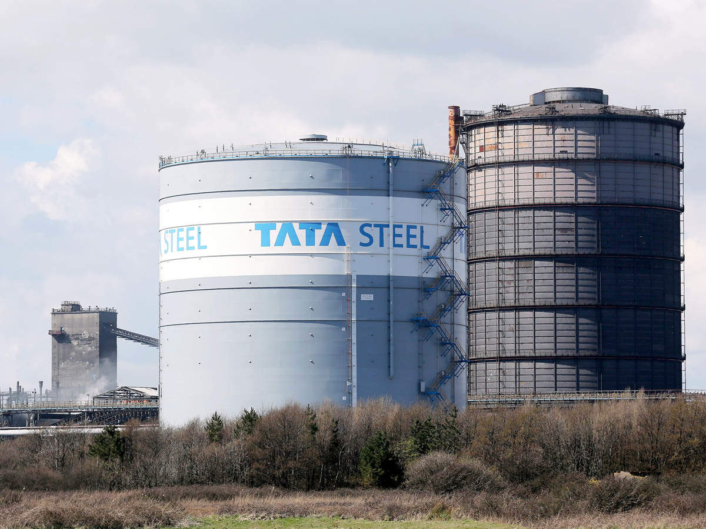
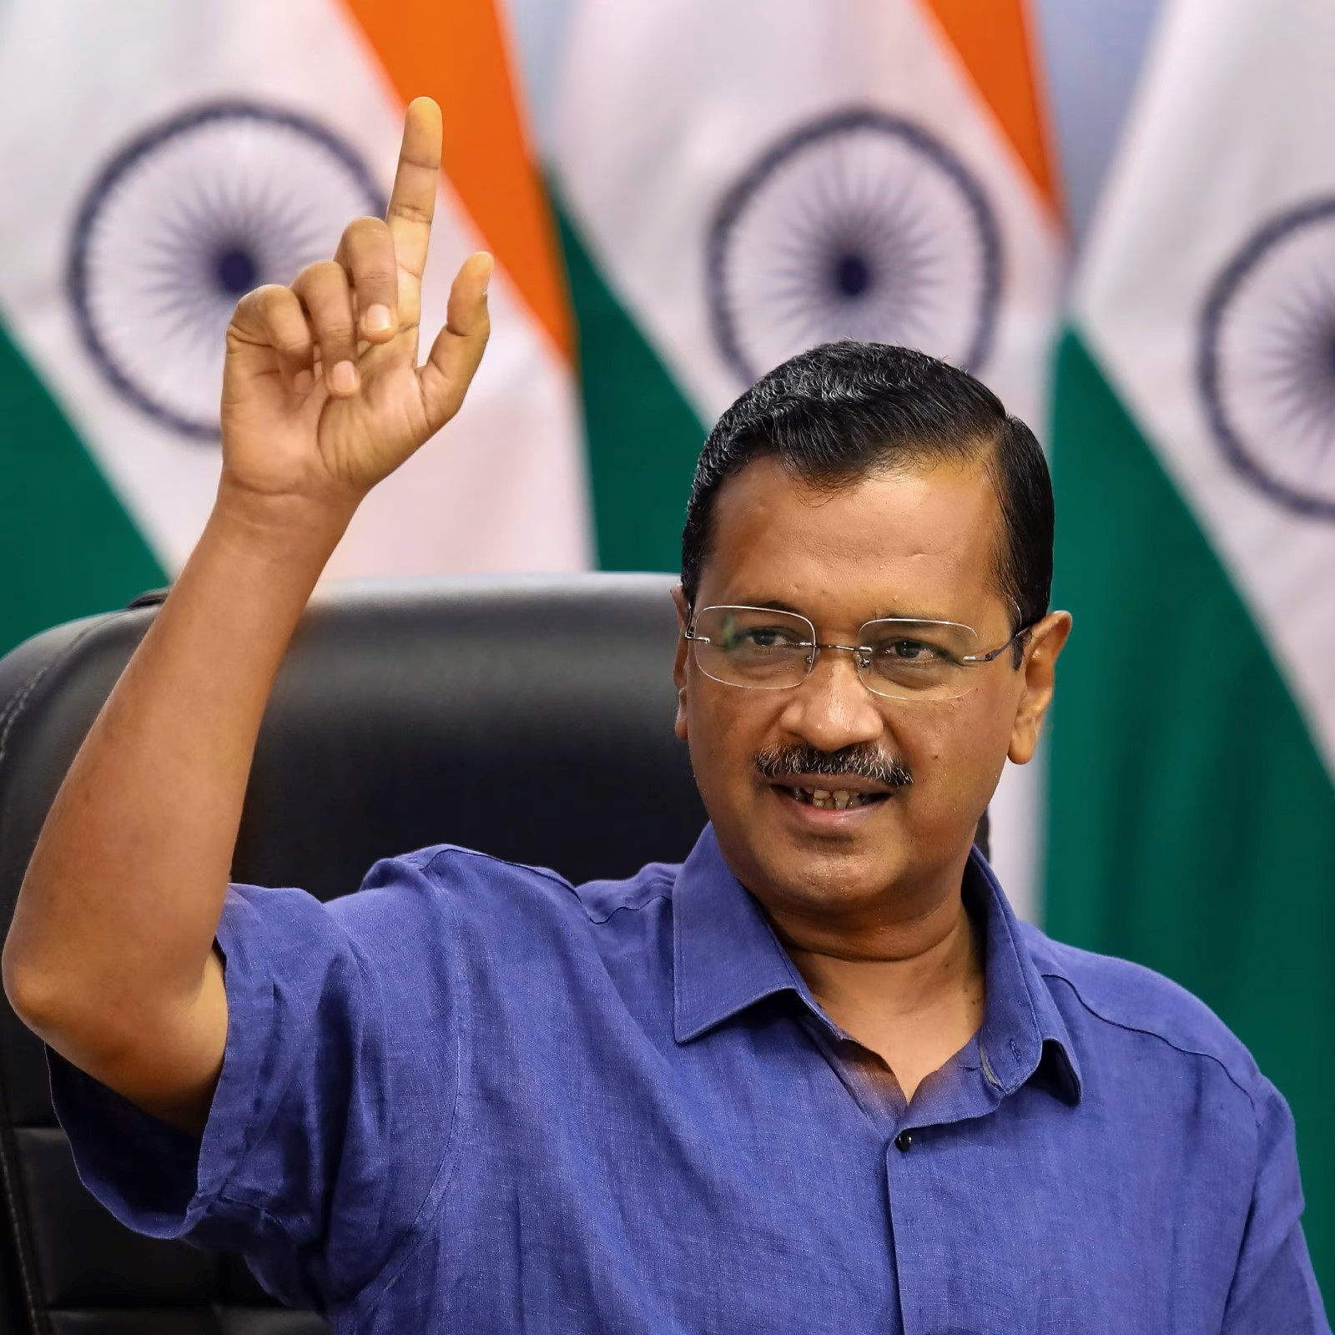
Education and Career
Born
Schooling
Graduation
Job
Civil Servant
Born in Haryana on August 16,1968. Son of Gobind Ram Kejriwal and Gita Devi
Completed schooling from Holy Child School at Sonipat
Completed Graduation from IIT, Kharagpur in mechanical engineering
Joined Tata Steel Company in Bihar (1989-1992)
Joined Indian Revenue Service as an Assistant Commissioner of Income Tax in New Delhi (1995- 2006)
3

Slide 4
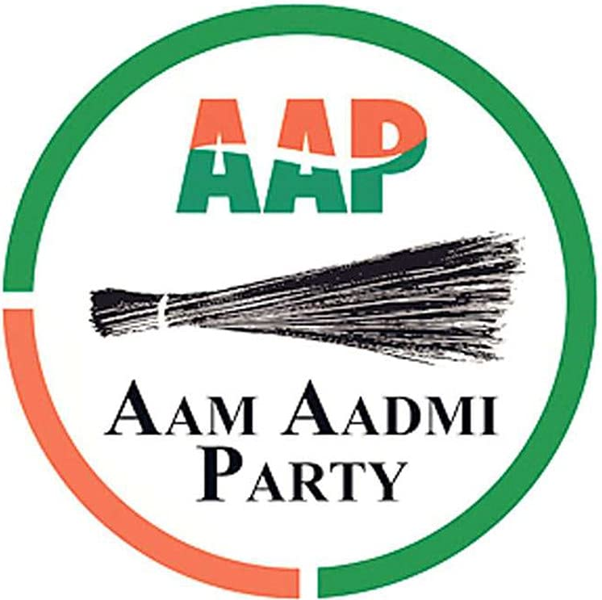
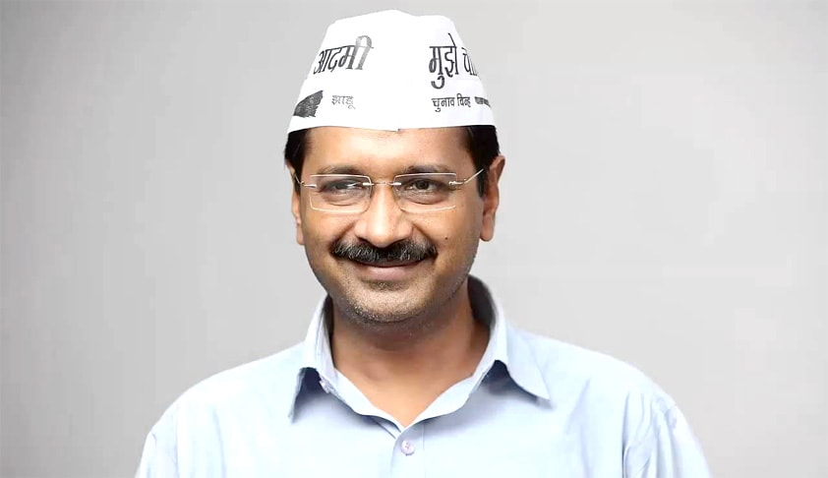
Political Career
Volunteered with Missionaries of Charity with Ramakrishna Mission
Became prominent anti-corruption activist during IAC movement
Gained fame during the Jan Lokpal Bill campaign
Launched Aam Aadmi Party in 2012
3rd Term Chief Minister of Delhi(2013-2014,2015-2020,2020-)

Slide 5
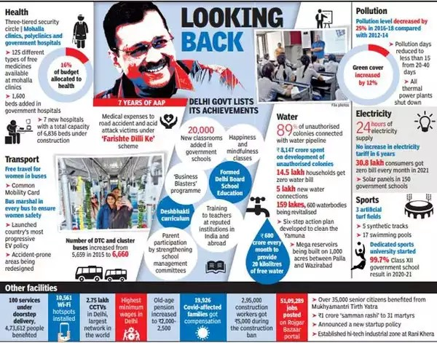

Kejriwal as Political Leader
➤ Launched the Mohalla Clinics Program
➤ Implemented the Odd-Even scheme
➤ Launched online portal 'Delhi Dialogue
5

Slide 6
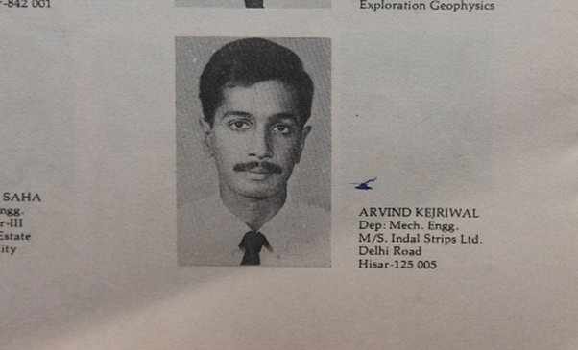
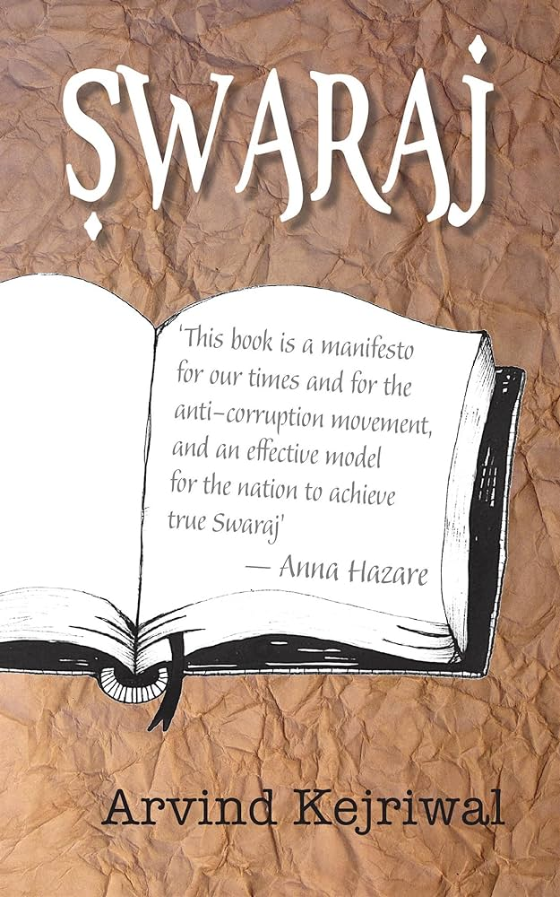
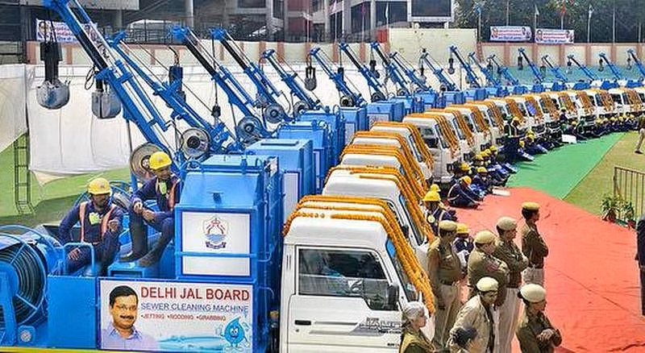
Kejriwal as Engineer
➤ Developed a software for the income tax department
➤ Innovated a road sweeping machine design
➤ Authored "Civil Services Examination: The Engineer's Ultimate Guide“ , “Swaraj”
6

Slide 7
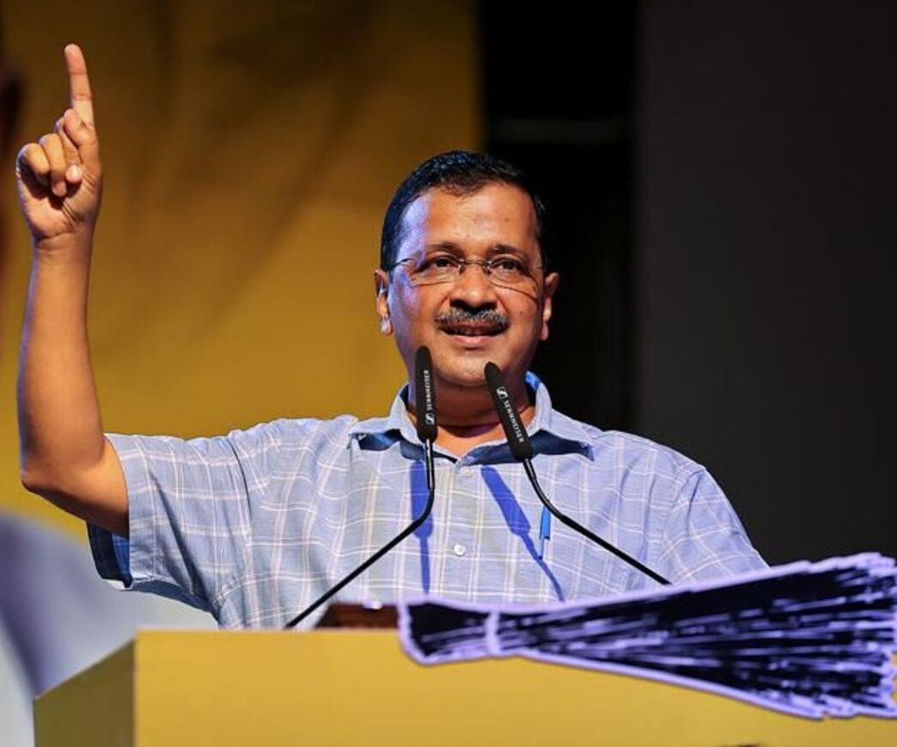
Leadership traits
Ability to connect with people
Transparency
Willingness to experiment
Focus on people- centric policies
Decisiveness
7

Slide 8




Thank you
Do you have any questions?

